Slide 1
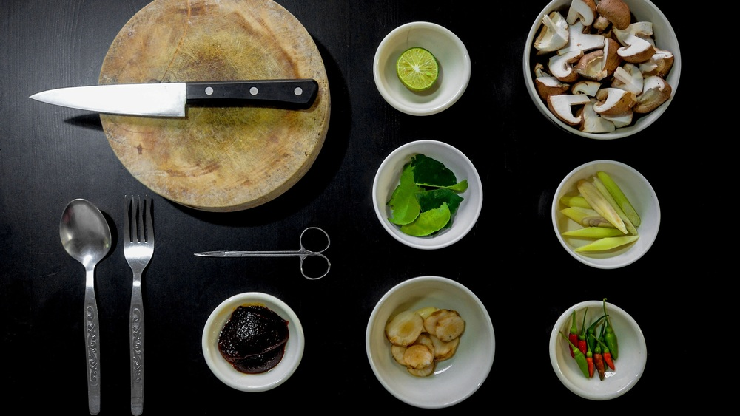
Culinary Solutions
Final Term Project – 2021 Fall - IT STRATEGY 22:544:670
Group 7:
Anshul Jaiswal
Devendra Shankar Gaud
Harsh Pratap Singh
Shrutee Verma
Yashasvi Sharma

Slide 2
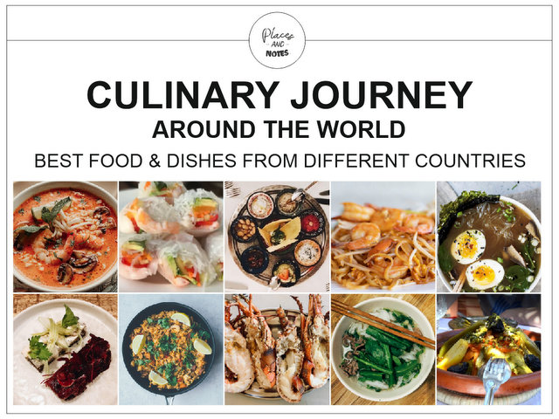

Slide 3
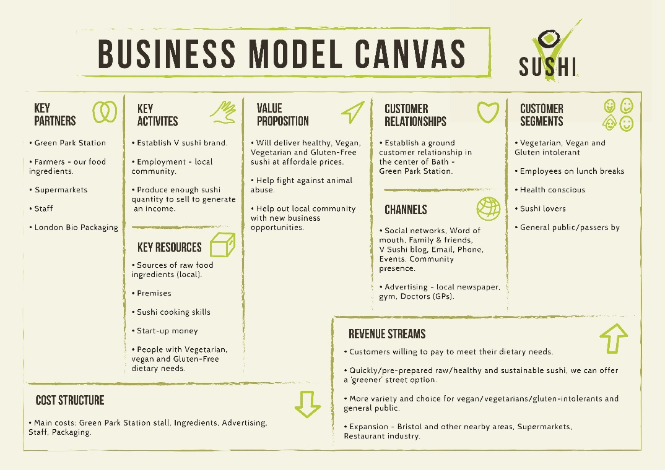
Culinary Solutions
Business Model
User Registration
Choose Cuisine
Recipe
Where user can get the ingredients?
User friendly app
Good privacy policies
Two stakeholders
Users
Stores

Slide 4
Culinary Solutions
IT Strategy
Technology setup & structure
- Amazon Web Services
- Amazon management console
- Technology platform, Amazon EC2 (Elastic Compute Cloud)
- Mobile Application
- AWS Identity & Access Management (IAM)
- Partnership with youtube
- 24/7 helpdesk using chatbot

Slide 5
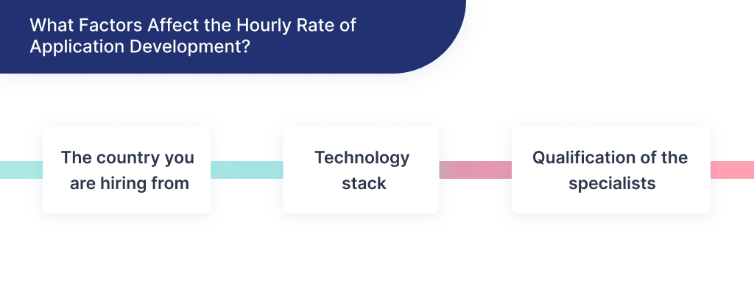
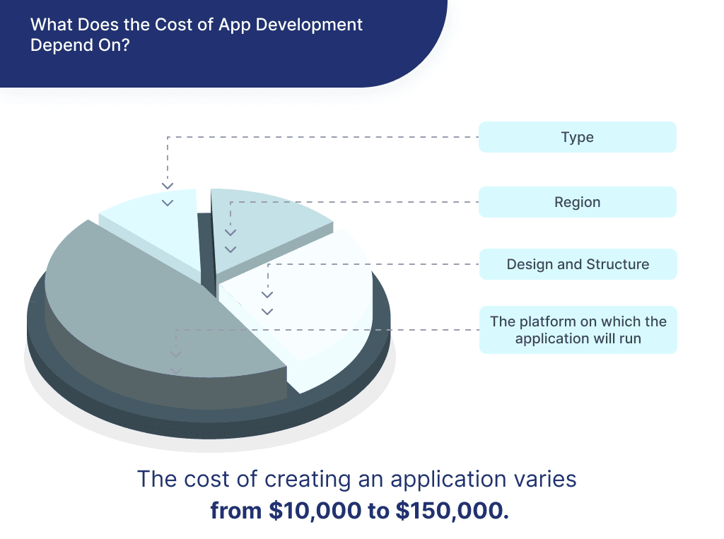
Culinary Solutions
Cost & Revenue Model
Before creating the mobile application, you need to analyse the target audience and business objectives, understand how to develop an app, and choose a platform to code.
Cost to build an app depends on three things –
The application’s complexity level
Design and Structure
The platform on which the application will run
Since the App would be free in its initial stage, we rely on Angel investors, several funding while offering Premium subscription to our users and In-app Advertisement.

Slide 6
Culinary Solutions
Porter's Five Forces
Rivalry among Existing Competitors:
- Recurring improvements, user-friendly environment and regular customer feedback.
The Threat of Substitute:
- Customer trust, Advertising via word of mouth and media, Customer attraction
via offers and coupons.
The Power of Suppliers:
- Best product quality at a very economical price.
The Power of Buyers:
- Customers with greater power to negotiate for lower prices and deals.

Slide 7
Culinary Solutions
Threat of Entry
1. Supply side economy of scale
2. Demand-side benefits of scale
3. Customer switching cost
4. Capital requirements
5. Incumbency (leader) advantages independent of size
6. Unequal access to distribution channels
7. Restrictive government policy

Slide 8
Culinary Solutions
Marketing Strategy
Why we need marketing a plan?
Things to work on while planning:
1. Organizing a Pre-Launch Giveaway
2. Social Media Influence
3. Organic Visibility on web
4. Advertisements - Television
- Amazon
5. Email Marketing

Slide 9
Culinary Solutions
Launching Our Product
What is Soft Launch and why it is important for our product ?
Just after the Soft Launch what is the must thing to be taken care?
Our product is ready for its Final Launch.
Post Launch Activities

Slide 10
Thank you

